Slide 1
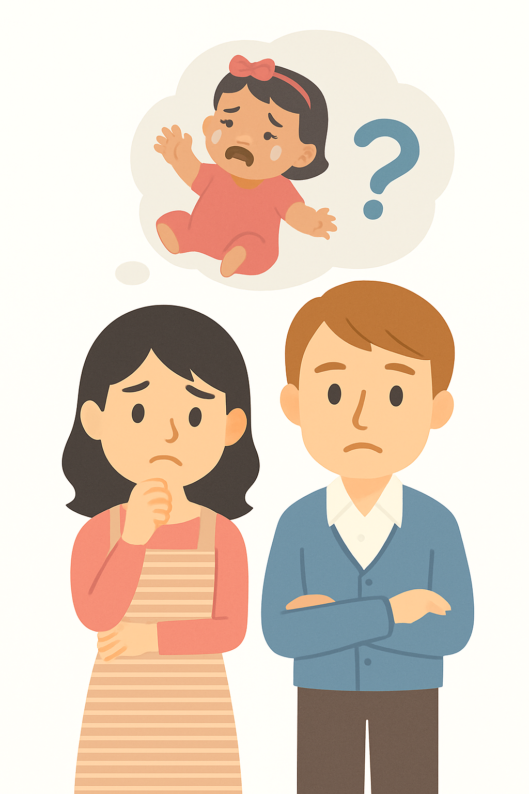
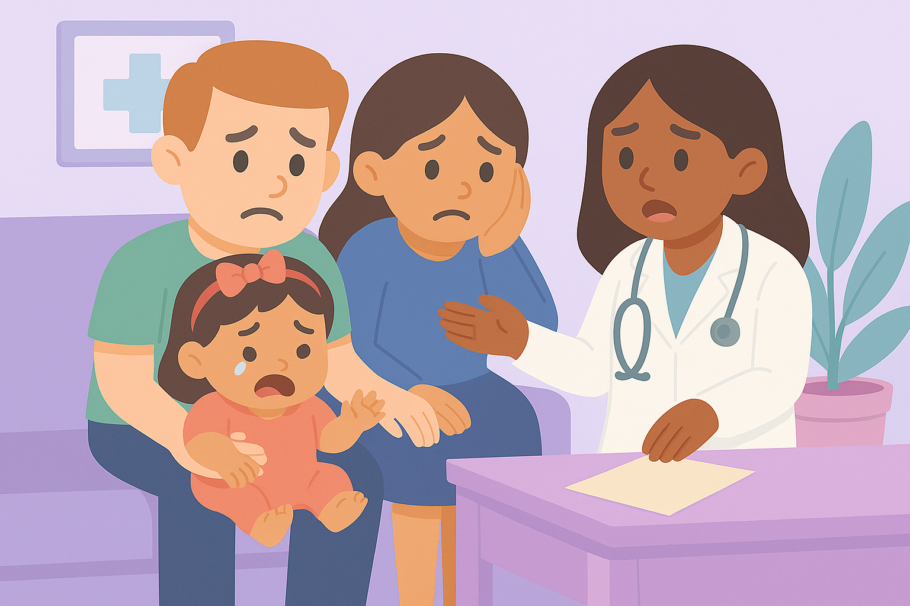














Meet Emma
When Emma was born, everything seemed fine.
But as months passed, Emma wasn’t sitting, crawling, or talking like other babies at the park.
Parents felt worried why the books milestones didn’t fit.
They finally got an answer — Down syndrome.
The diagnosis brought clarity but also uncertainty .
Birth
2m
4m
6m
8m
10m
Notes:
Let me introduce you to Emma. When Emma was born, everything seemed fine. But as months passed, her parents noticed she wasn’t sitting, crawling, or talking like other babies at the park. Naturally, they felt worried and unsure why the typical book’s milestones didn’t fit their little girl. After a period of uncertainty, they finally got an answer — she was diagnosed with Down syndrome, a genetic condition that affects learning and development. The diagnosis brought clarity but no plan or next milestone.

Slide 2
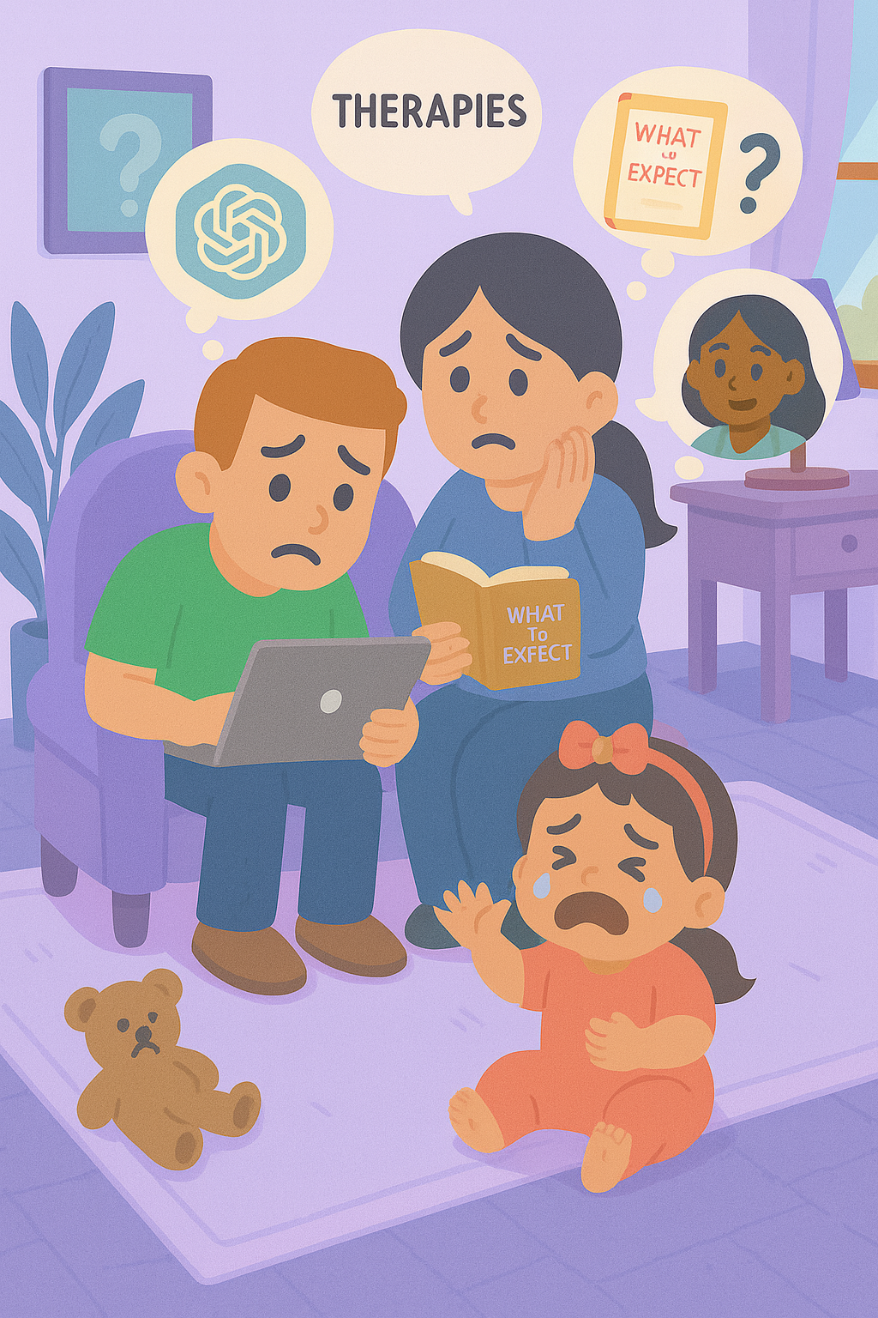
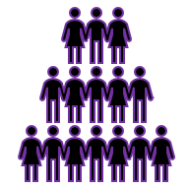

A Name, But NO Plan
MiLLIONS OF FAMILIES
Routines are hard to follow
and support often feels out of reach.
Guidance is fragmented
Notes:
According to the 2022 National Survey of Children’s Health, about 10.7% of all children ages 0–17 in the US, approximately 7.8 million children, receive developmental special services, such as speech, occupational, or physical therapy. Just like Emma’s, these families are navigating the care system, but the guidance they find is often fragmented, routines are hard to follow, and real support feels just out of reach.

Slide 3
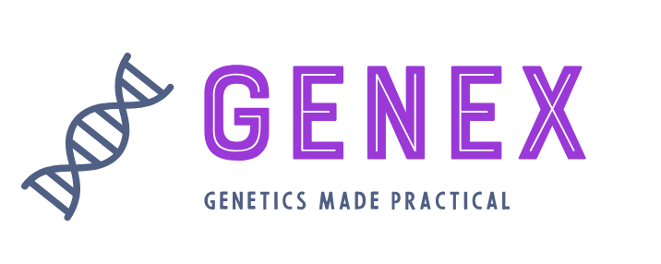
That’s why we built Genex
Notes:
That’s why we built Genex. Genetics made practical.

Slide 4



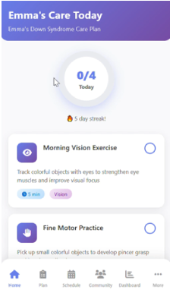




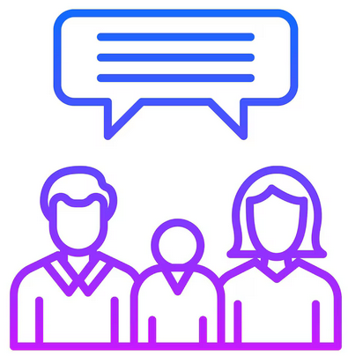

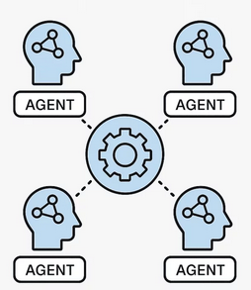

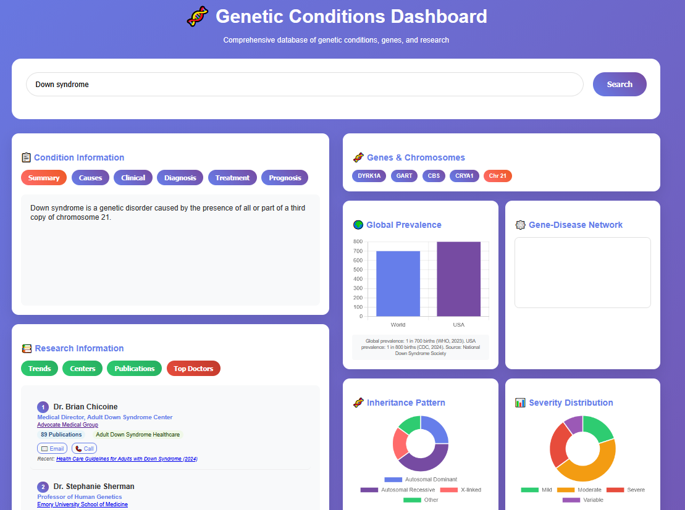
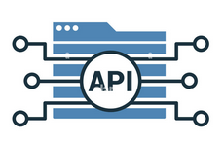

Genex – Technology
An AI care framework that learns with every family
Genex Core AI
Knowledge Graphs
Notes:
Genex technology unifies data from various sources. At its core lies a biomedical knowledge graph, where micro-agents and language models work together to interpret complex genomic and clinical data. This intelligence powers the Genex App and the Dashboard.

Slide 5

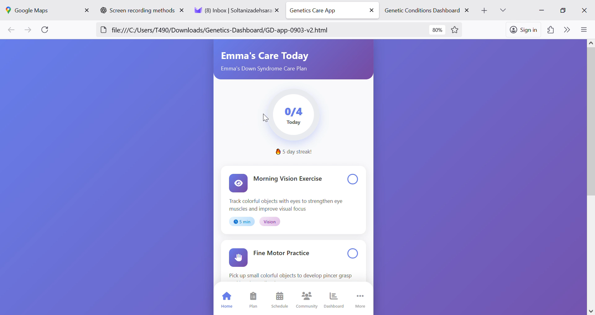
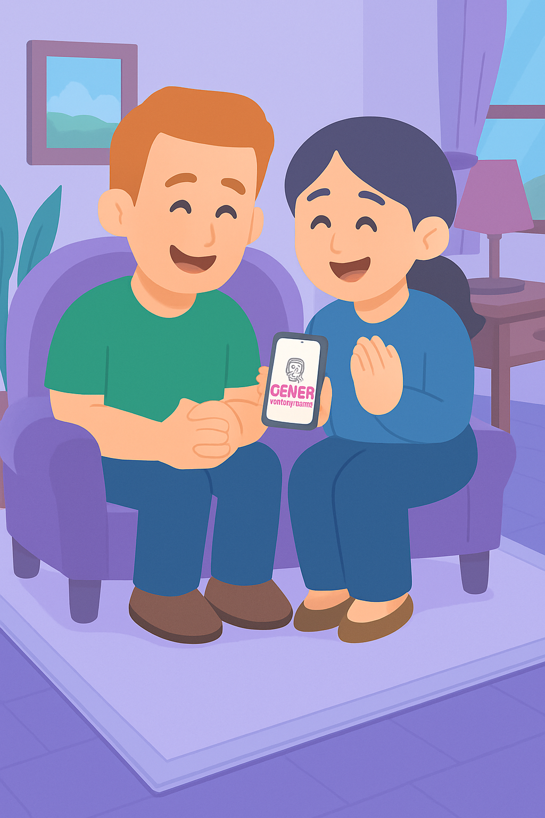
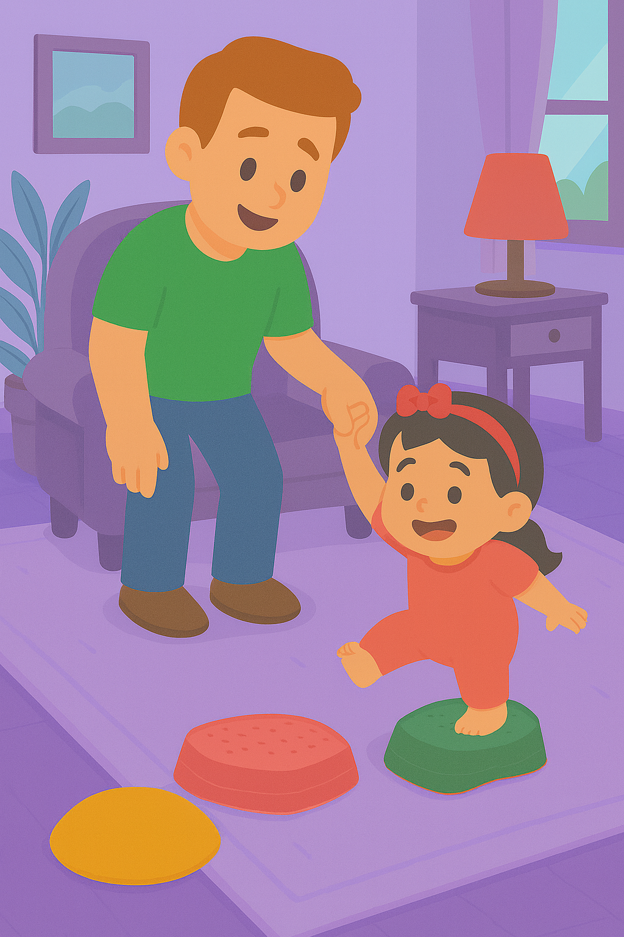
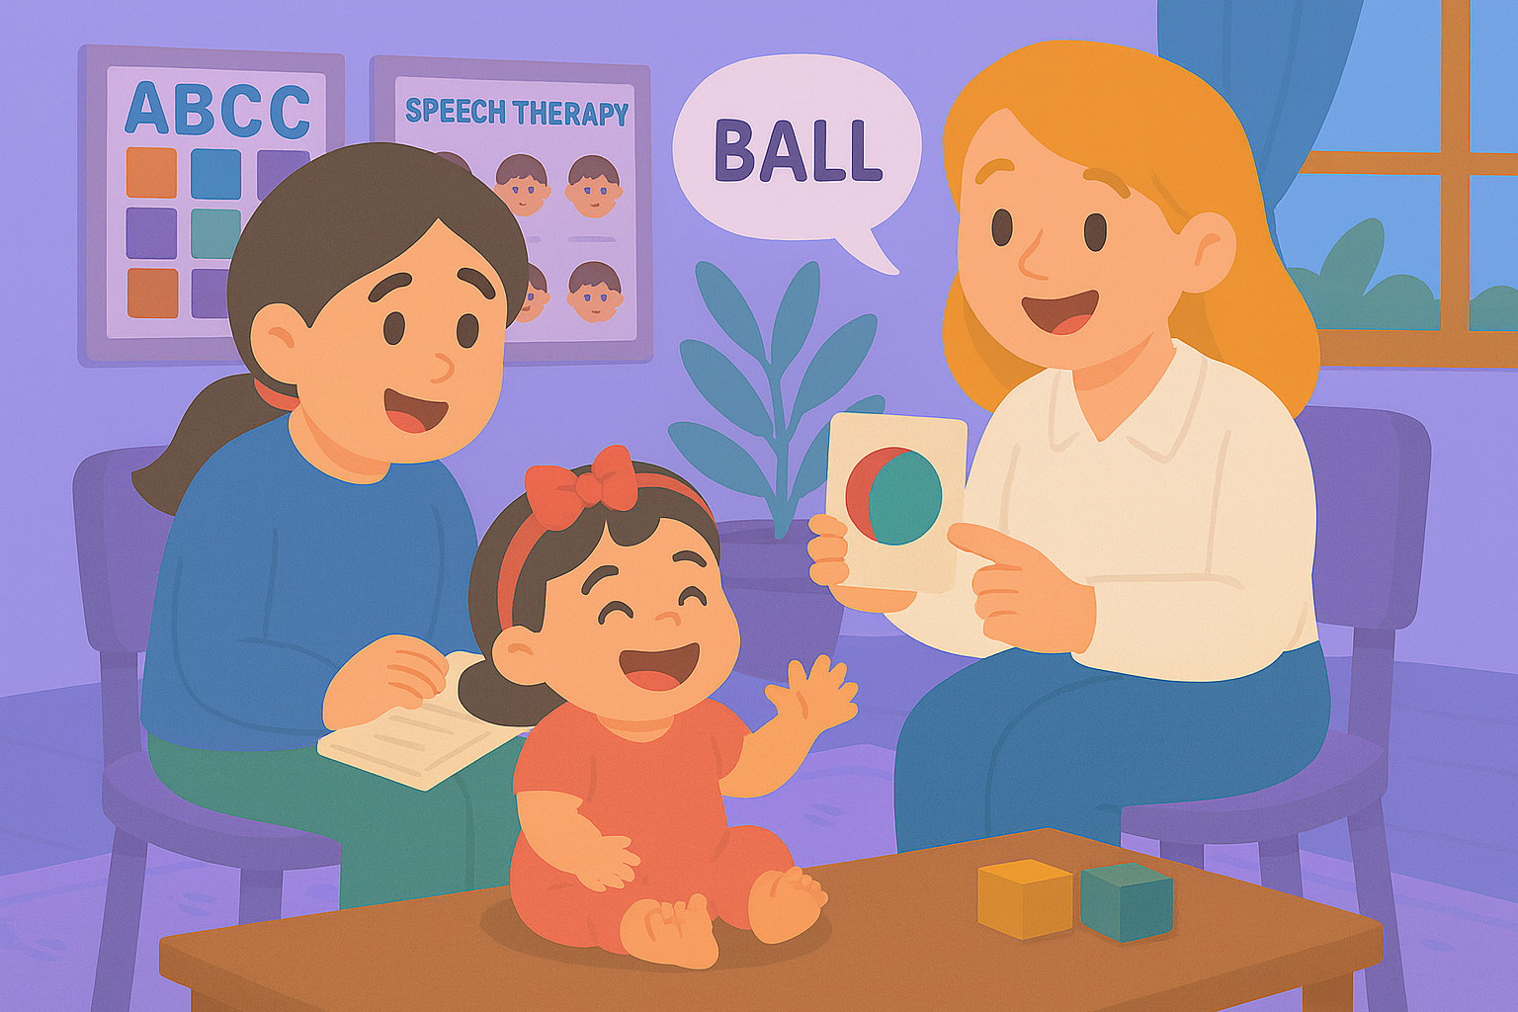
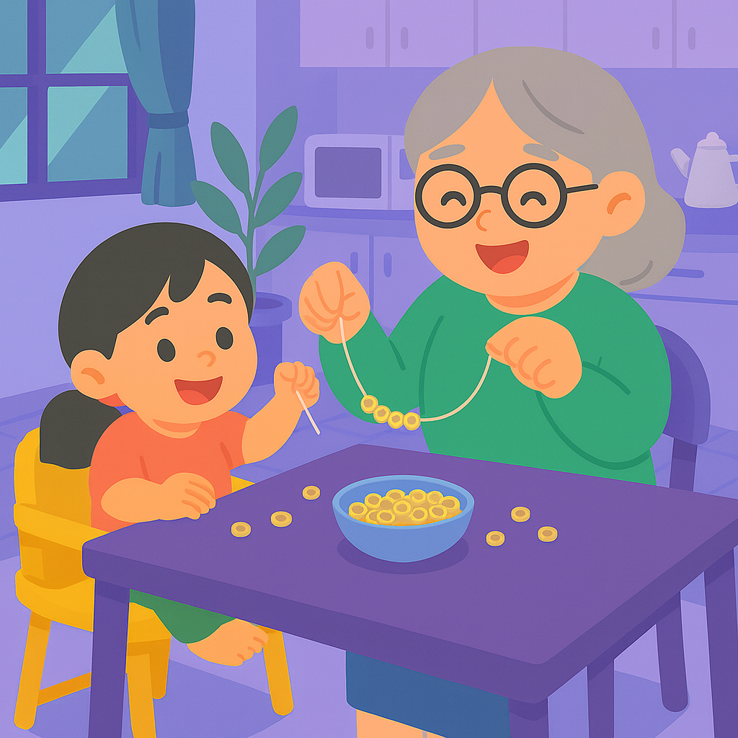
Introducing Genex – App
Care plans and curated daily 5–10 minutes activities
Gentle reminders and Progress tracking
A supportive community
Multilingual & Free
Helps:
families gain confidence
Teachers and therapists stay aligned
Children get consistent support — every single day.
Notes:
Genex App offers personalized care plans, curated 5 to 10-minute daily activities, gentle reminders, progress tracking, and — most importantly — a supportive community. Through the Genex App, families gain confidence, teachers and therapists stay aligned, children get consistent support — every single day and no one has to walk alone. The best part? Genex is multilingual and free.

Slide 6
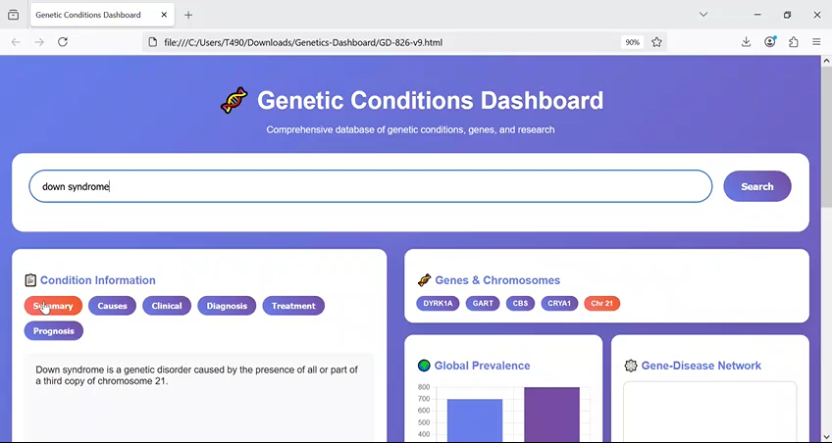
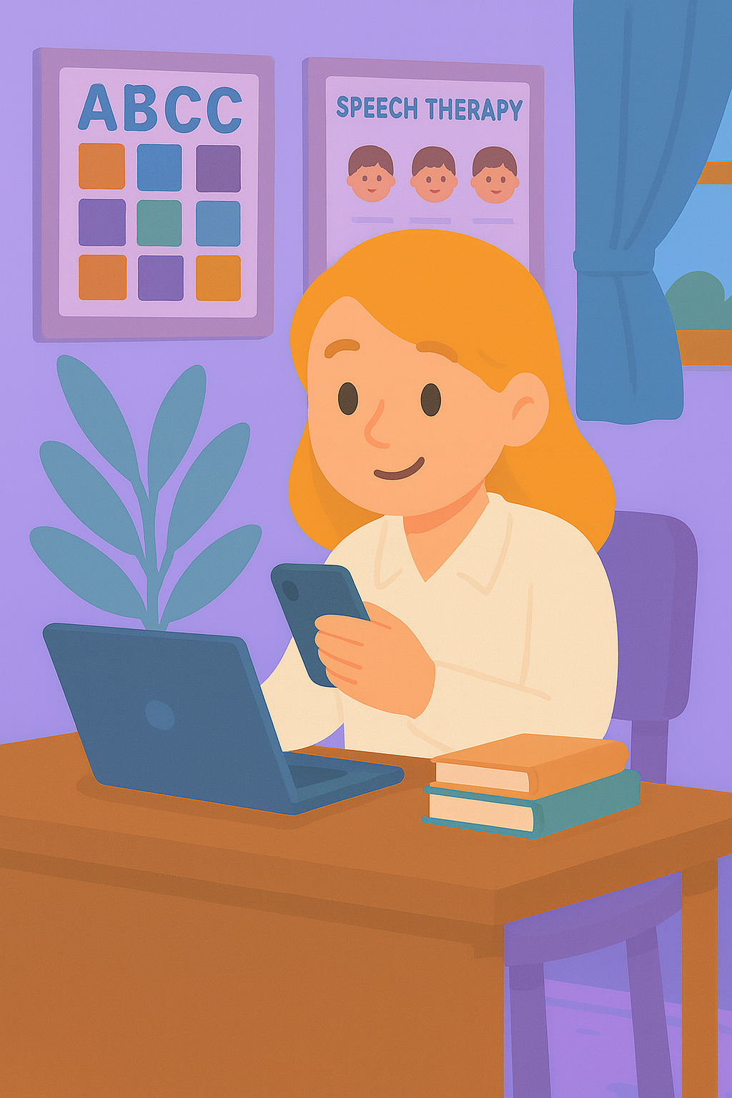
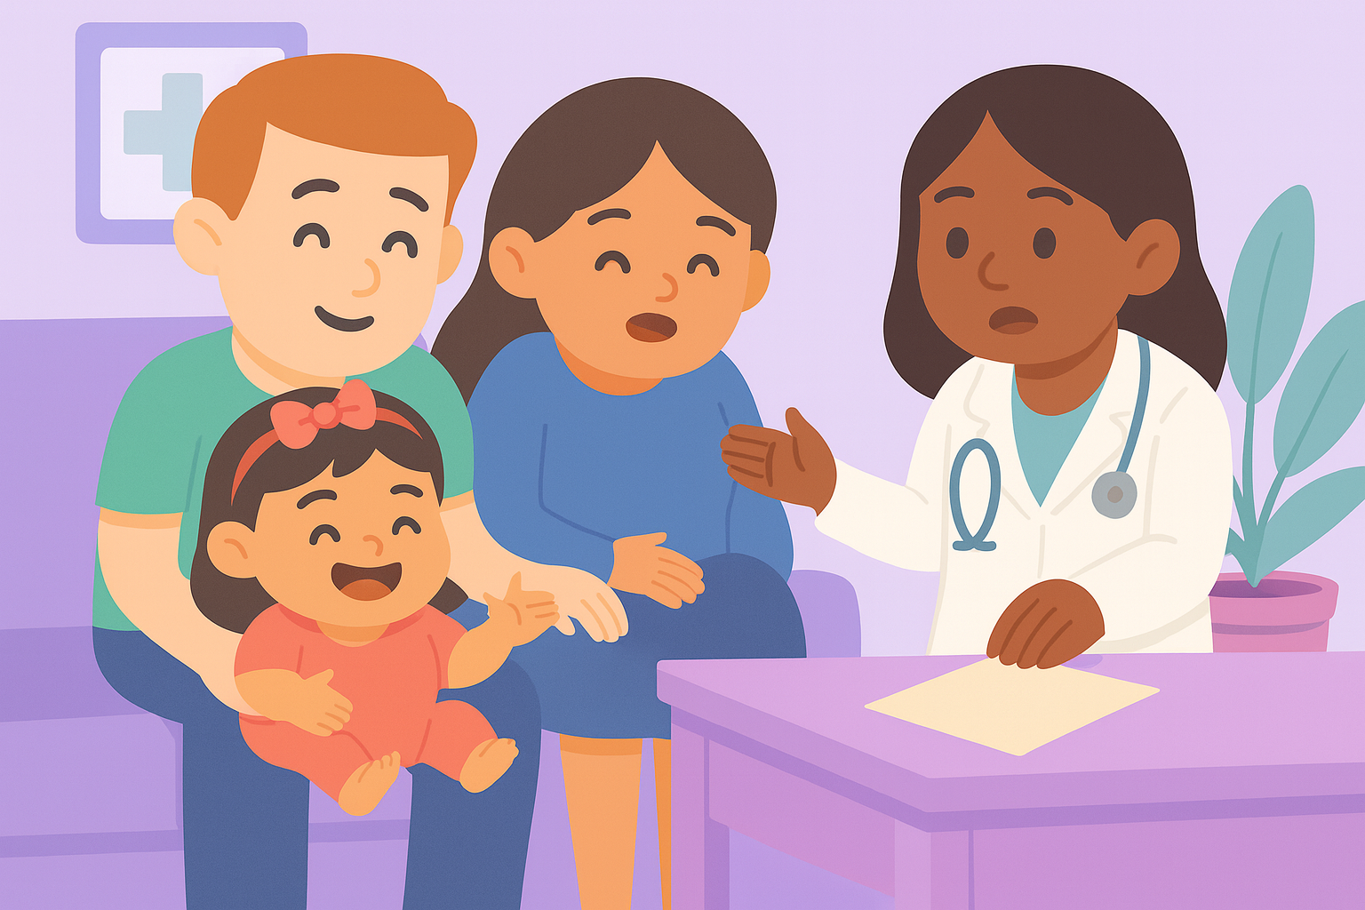
Introducing Genex – Dashboard
Offers:
Search and confidence-labeled info
At a glance visuals
Research lens including centers and top clinicians
Helps:
Families understand their child’s situation better
Know what to ask their doctors.
And providers give feeback.
Notes:
In addition to the application, Genex provides a free, intelligent dashboard. Instead of spending hours searching on Google, ChatGPT, or asking friends and relatives, Emma’s parents get access to one reliable hub with confidence-labeled information, visuals, and a research lens—so they know what to ask their doctors during the next visit, and clinicians can refine the plan.

Slide 7
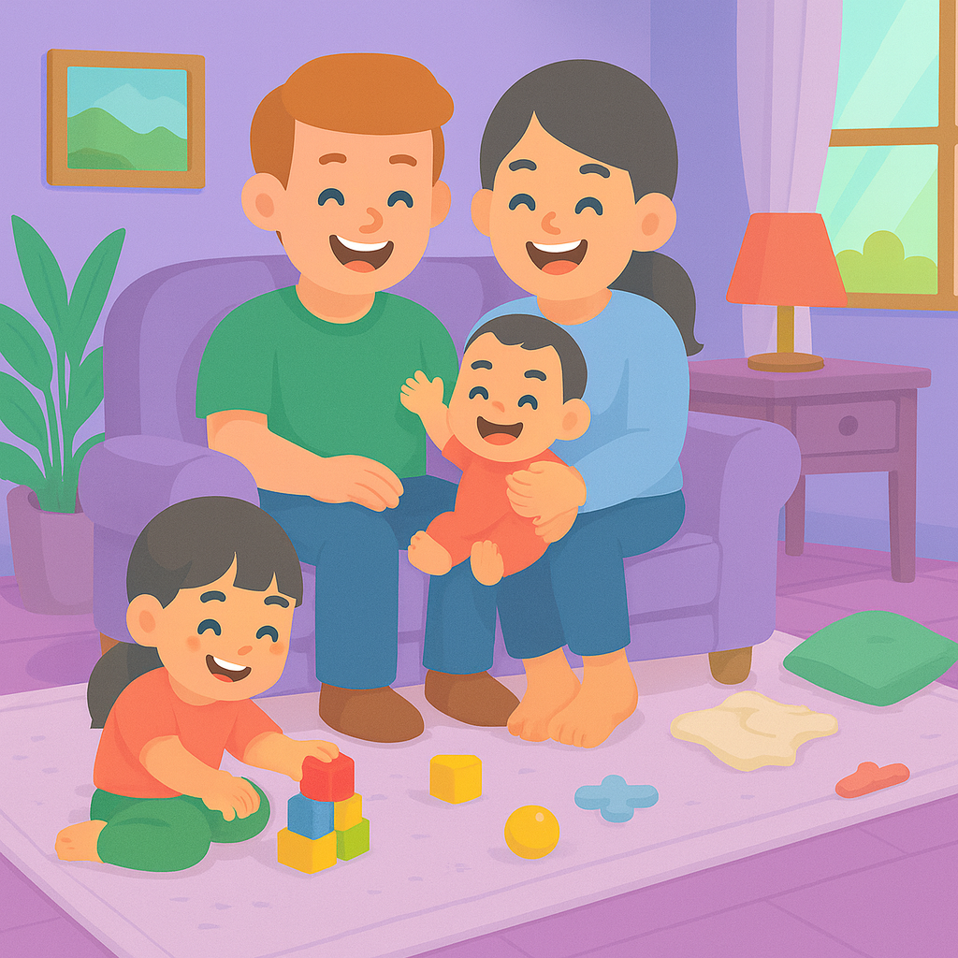
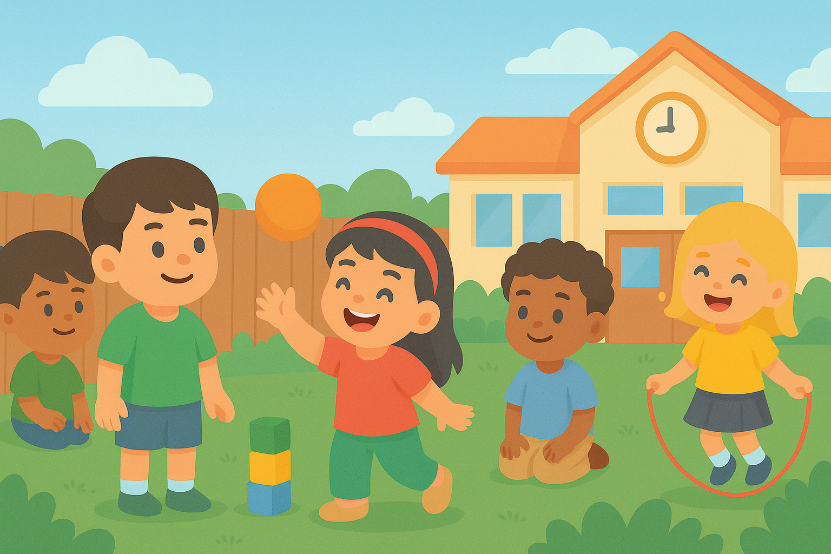
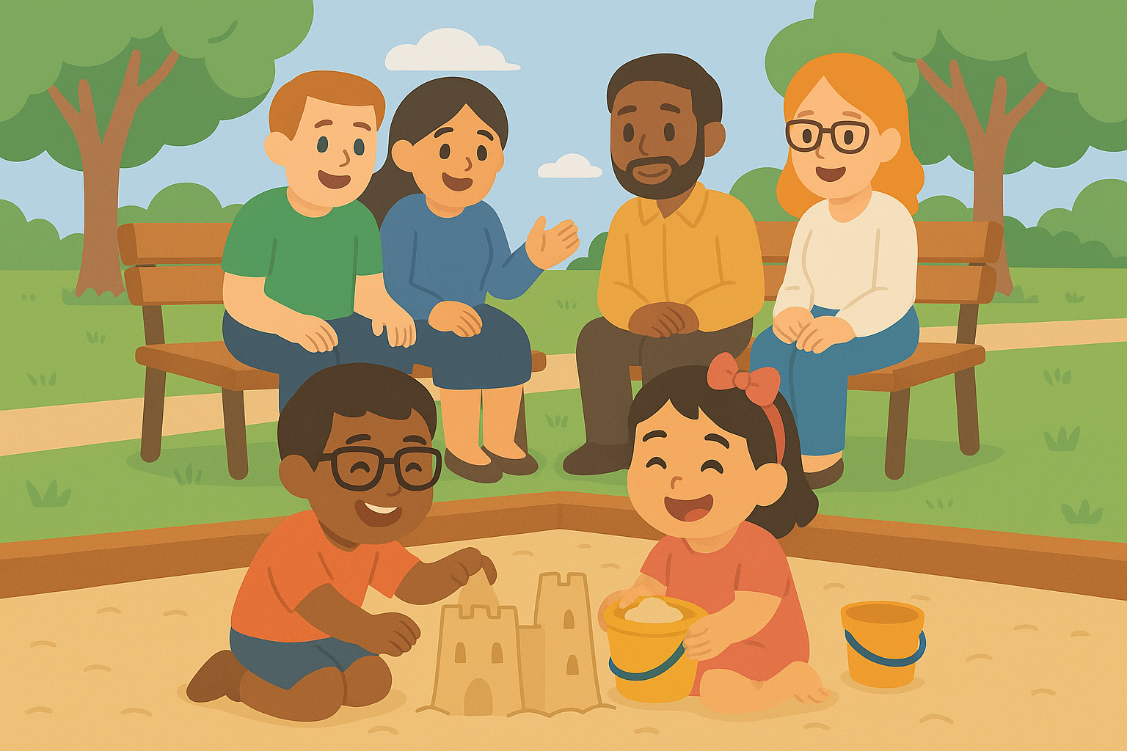
GeneX
Genetics Made Practical
Together we make care:
Simpler
Smarter
Supportive
Notes:
Together we make care simpler, smarter and supportive. GeneX , Genetics Made Practical.

Slide 8
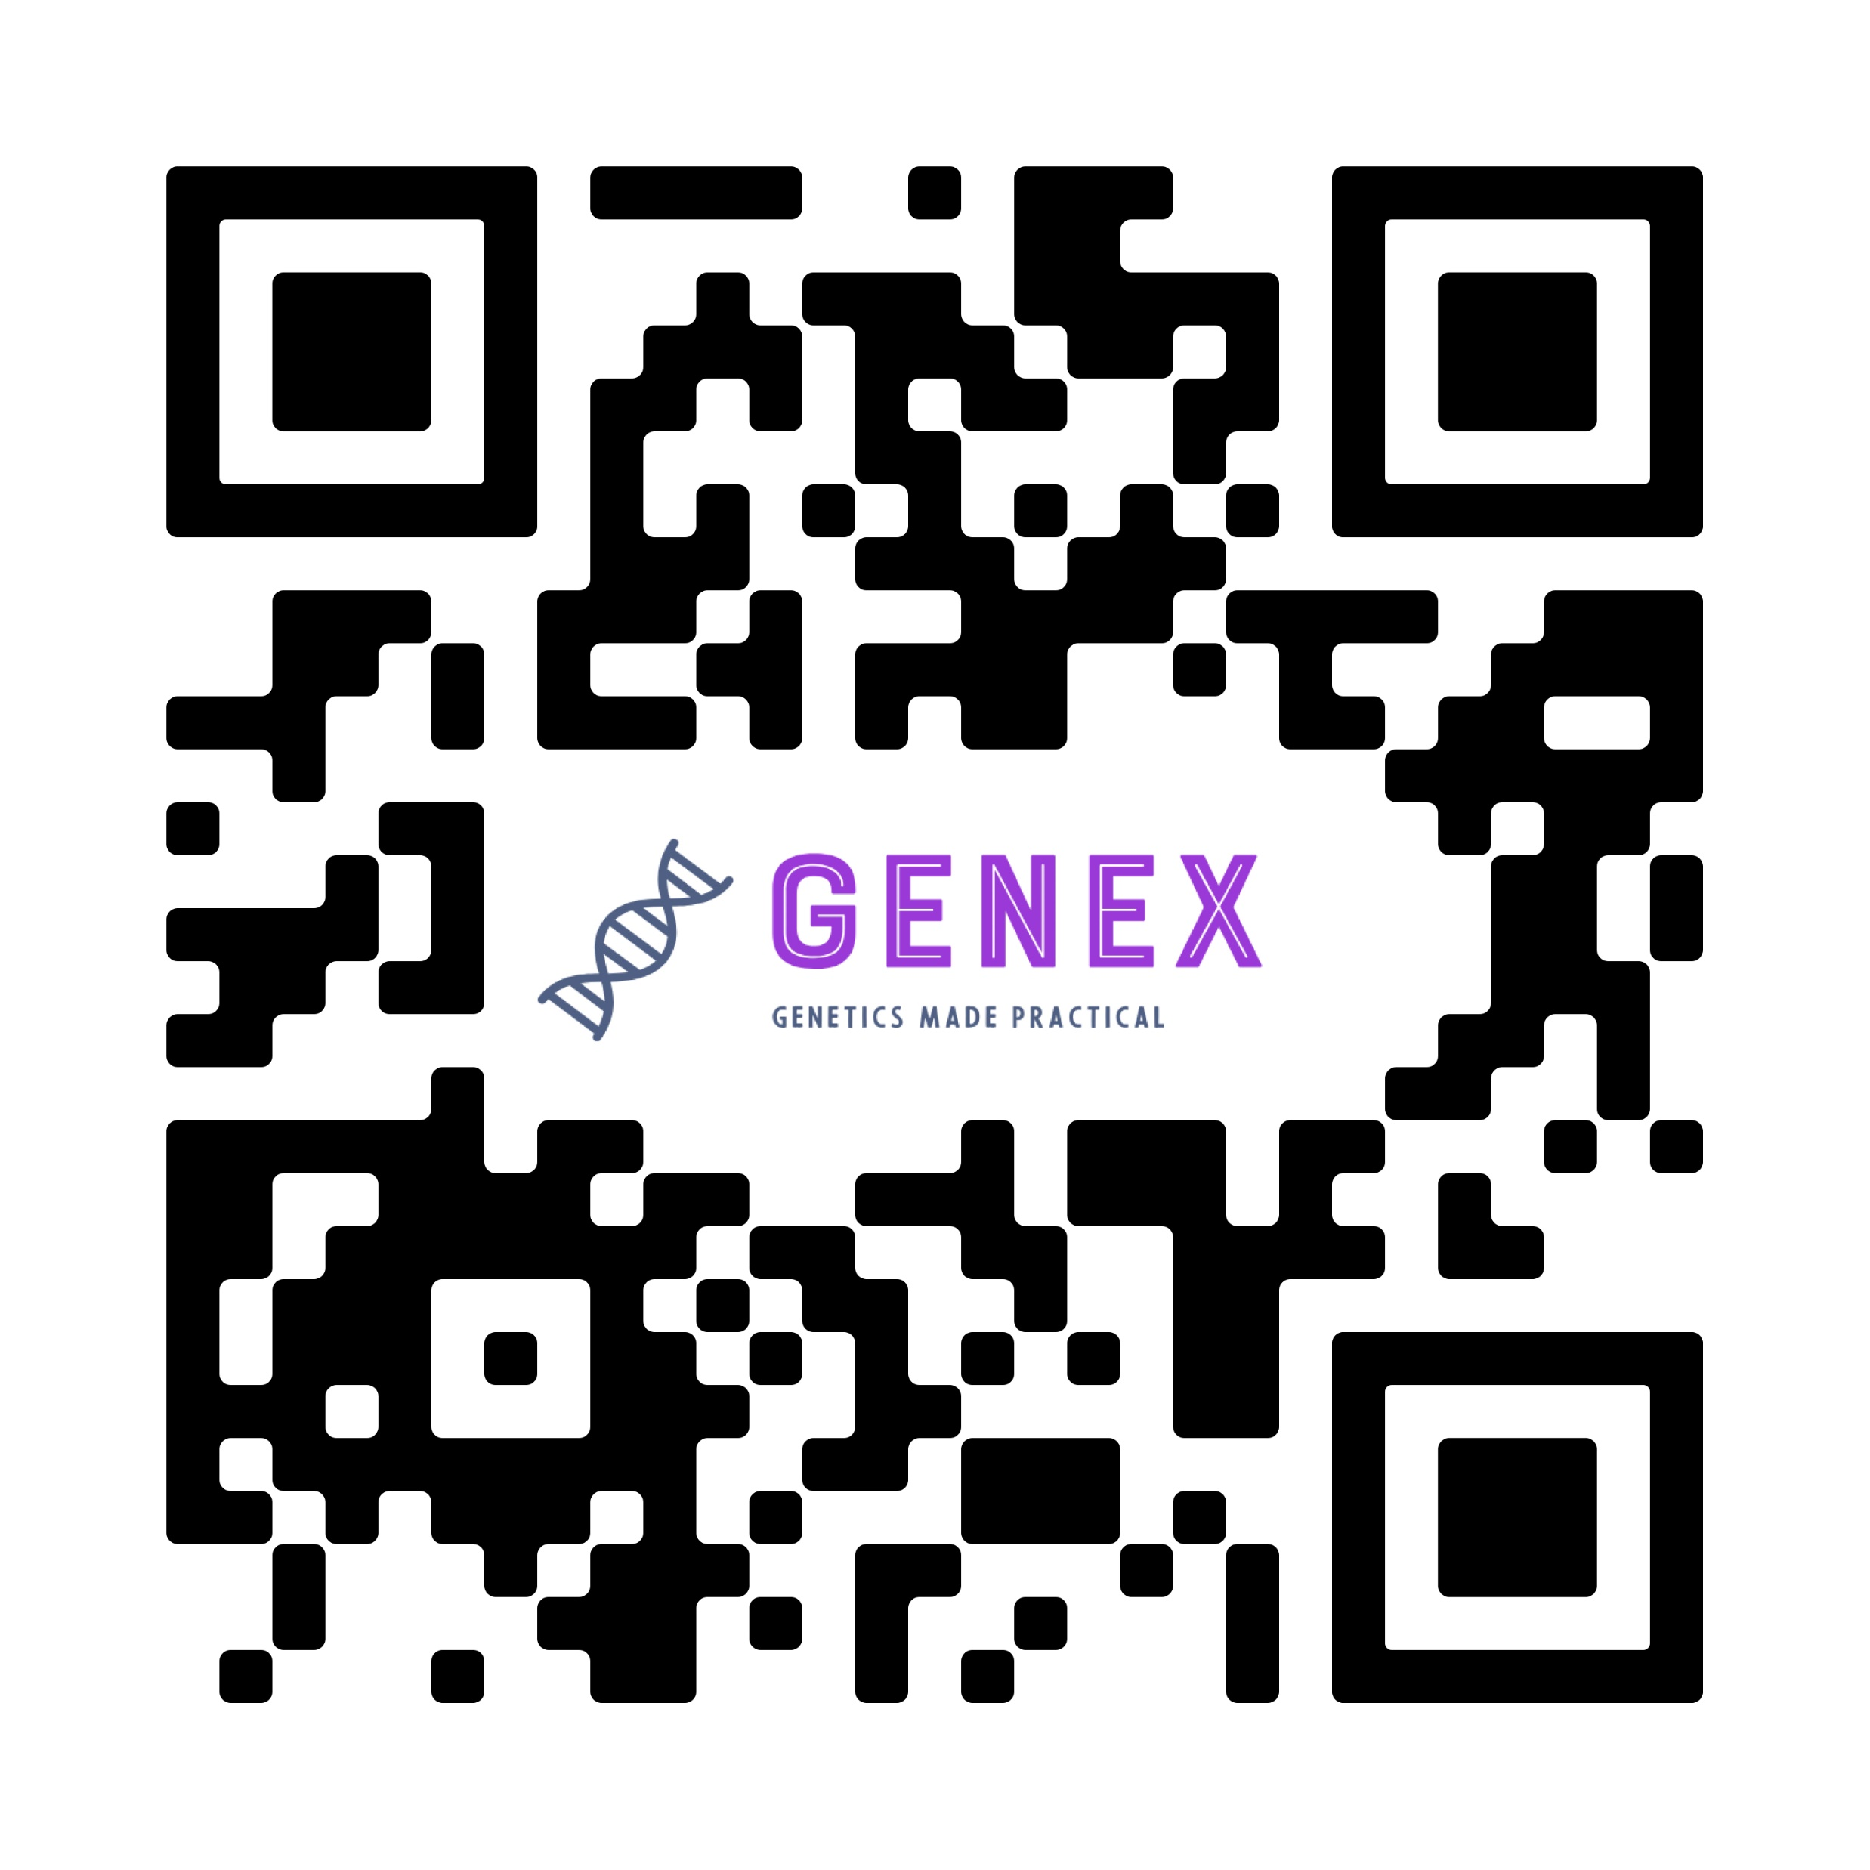
Join Emma’s family and a global community of parents learning, sharing, and growing together.
Scan the QR code to try our free app.
Notes:
Join Emma’s family and a global community of parents learning, sharing, and growing together. Scan the QR code to try our free app.

